Slide 1


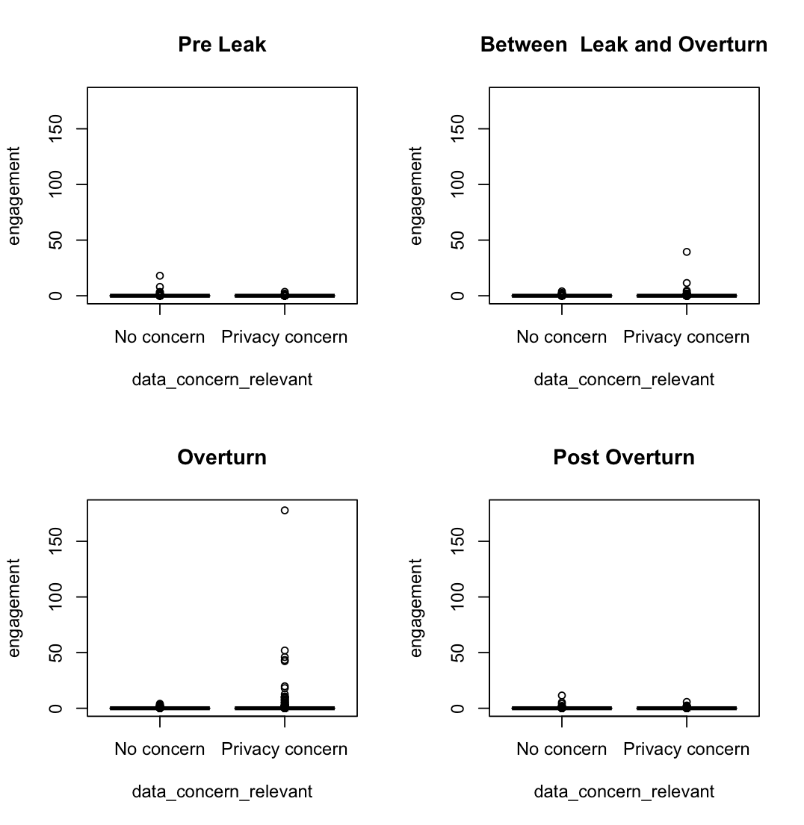
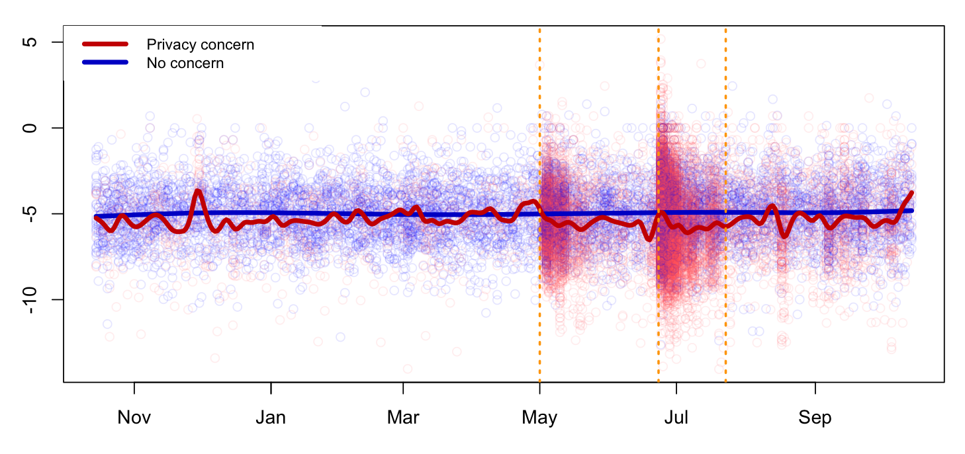
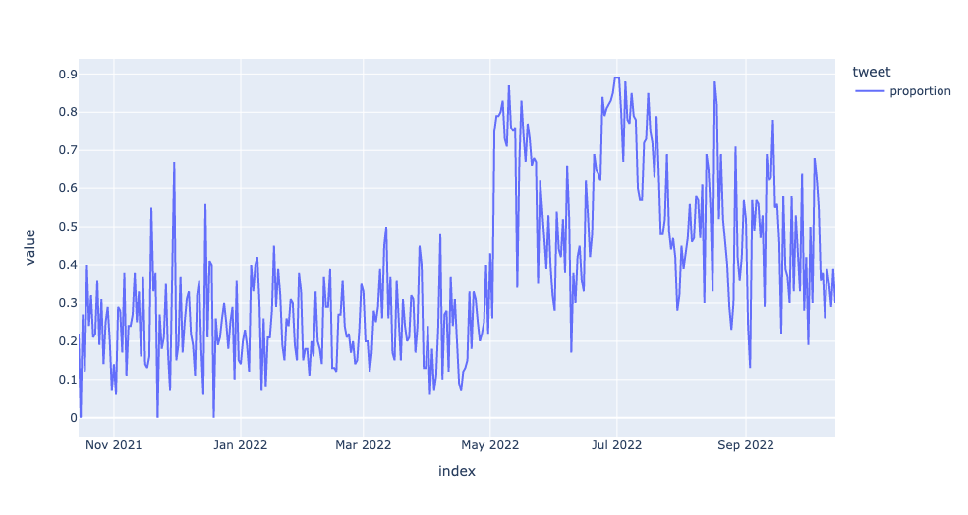
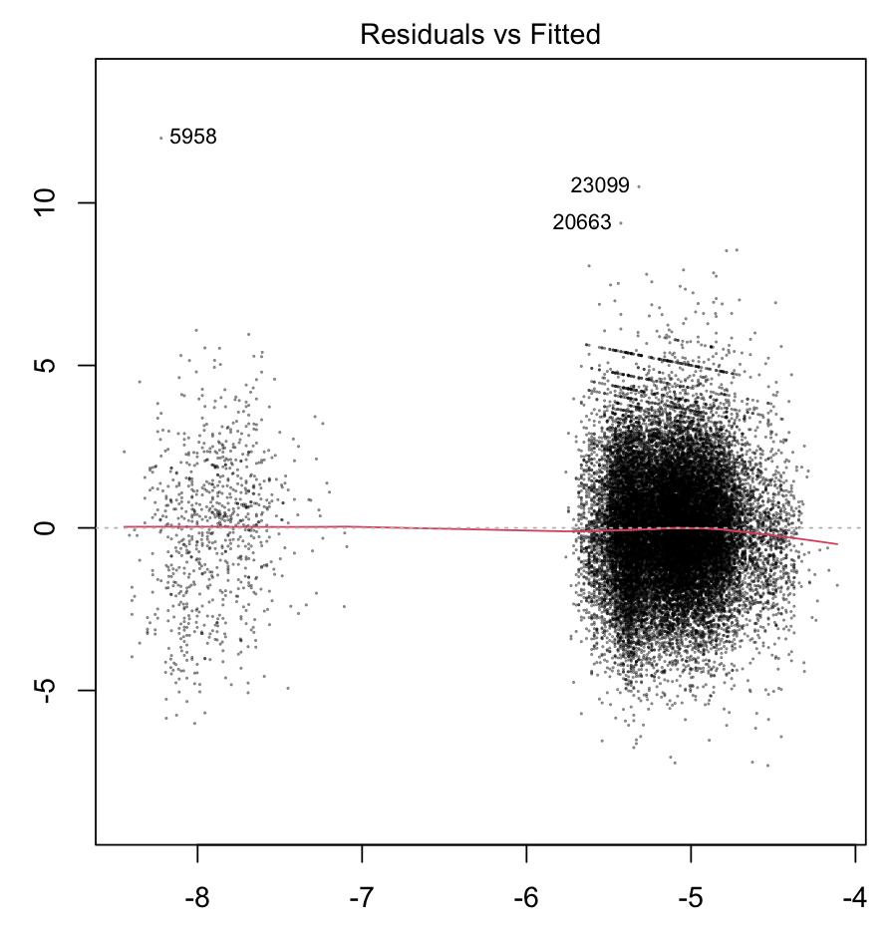
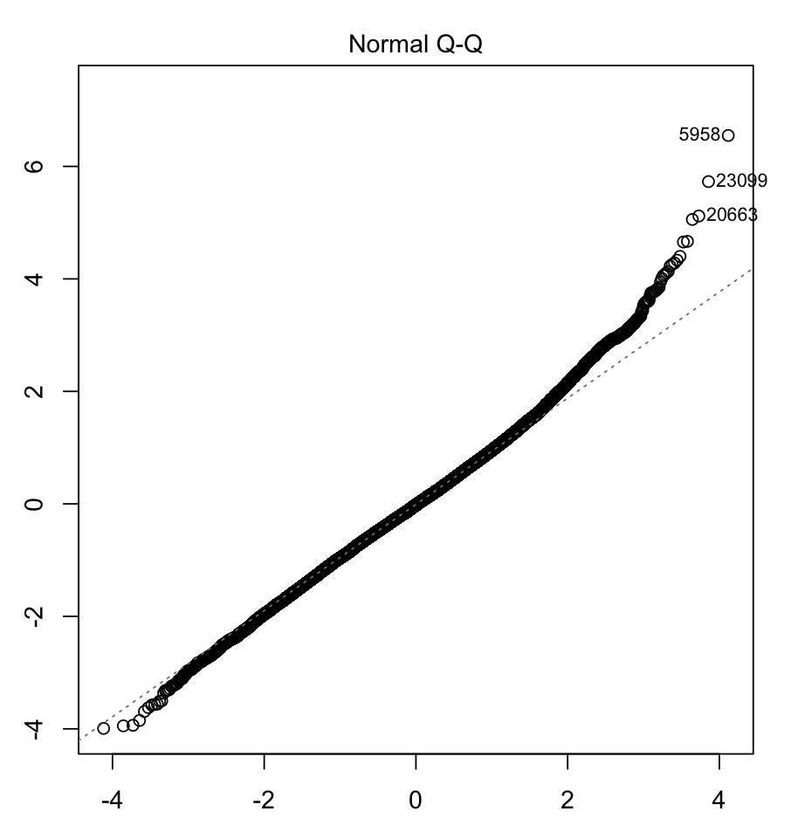
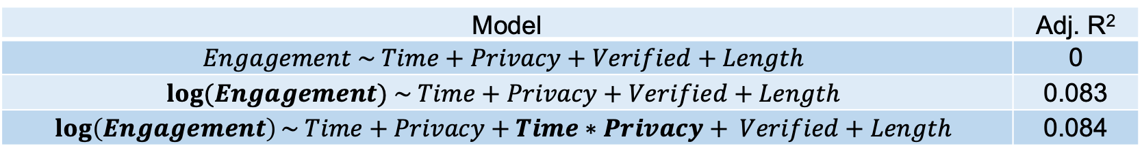
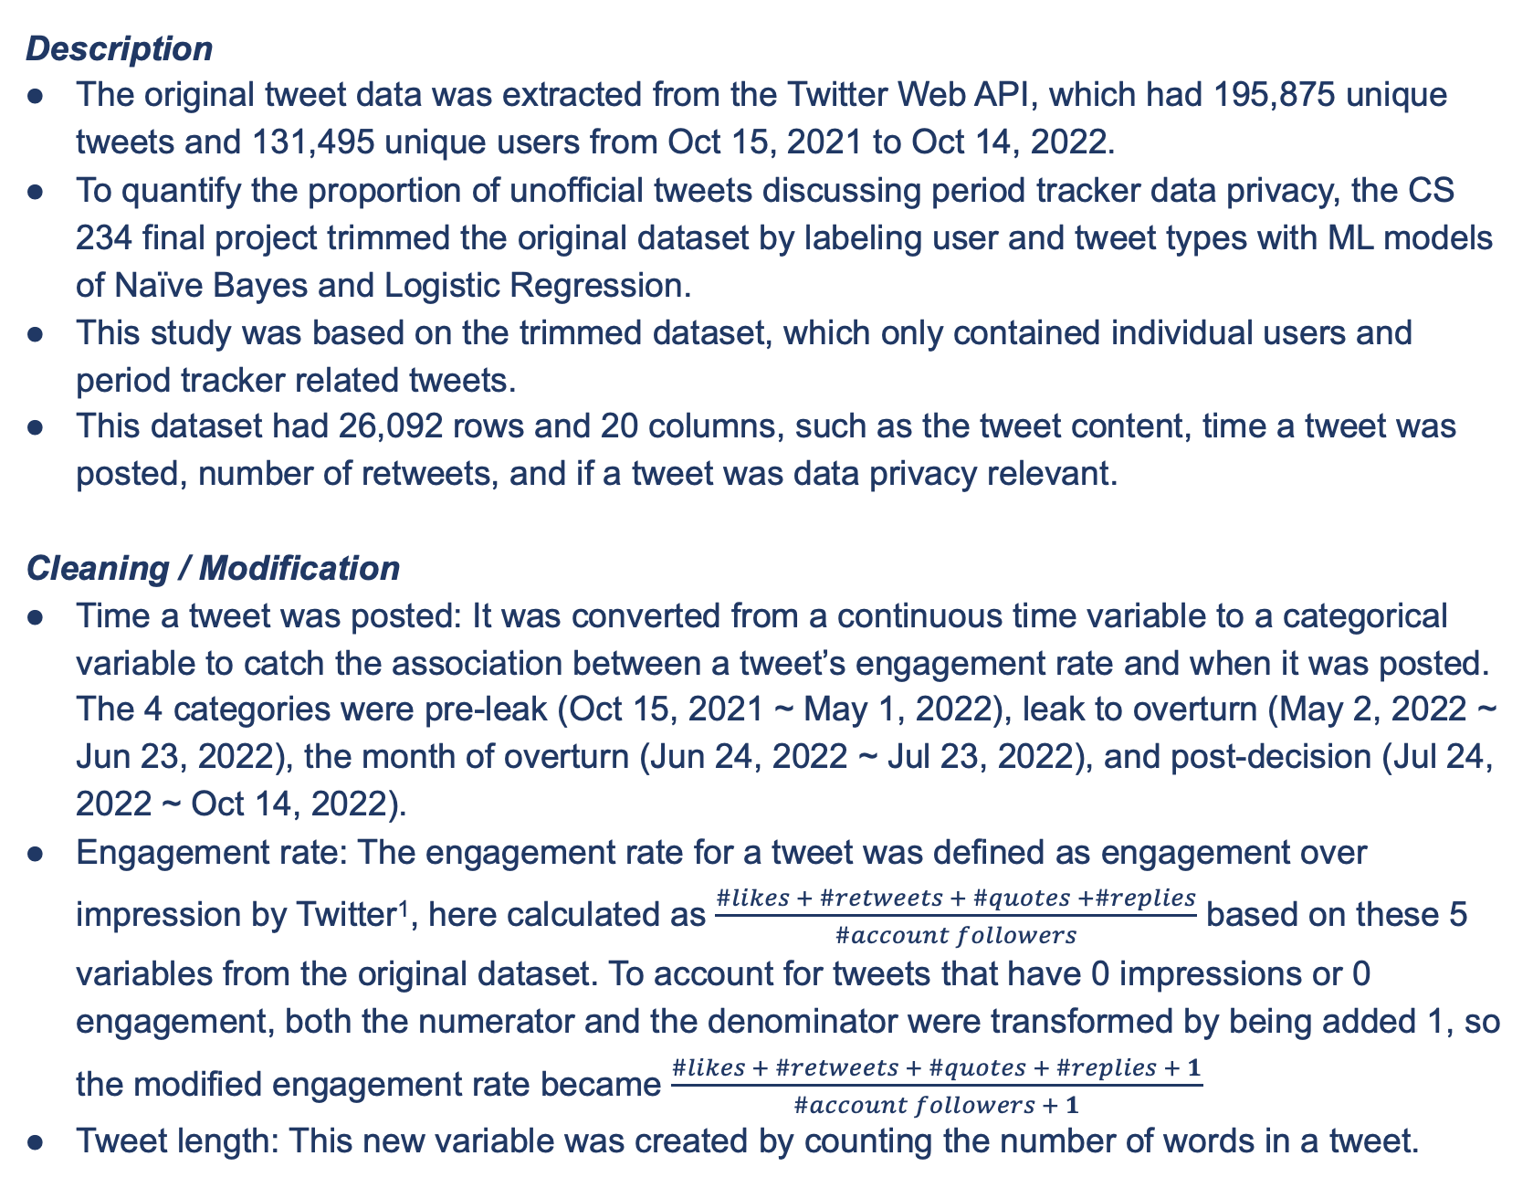
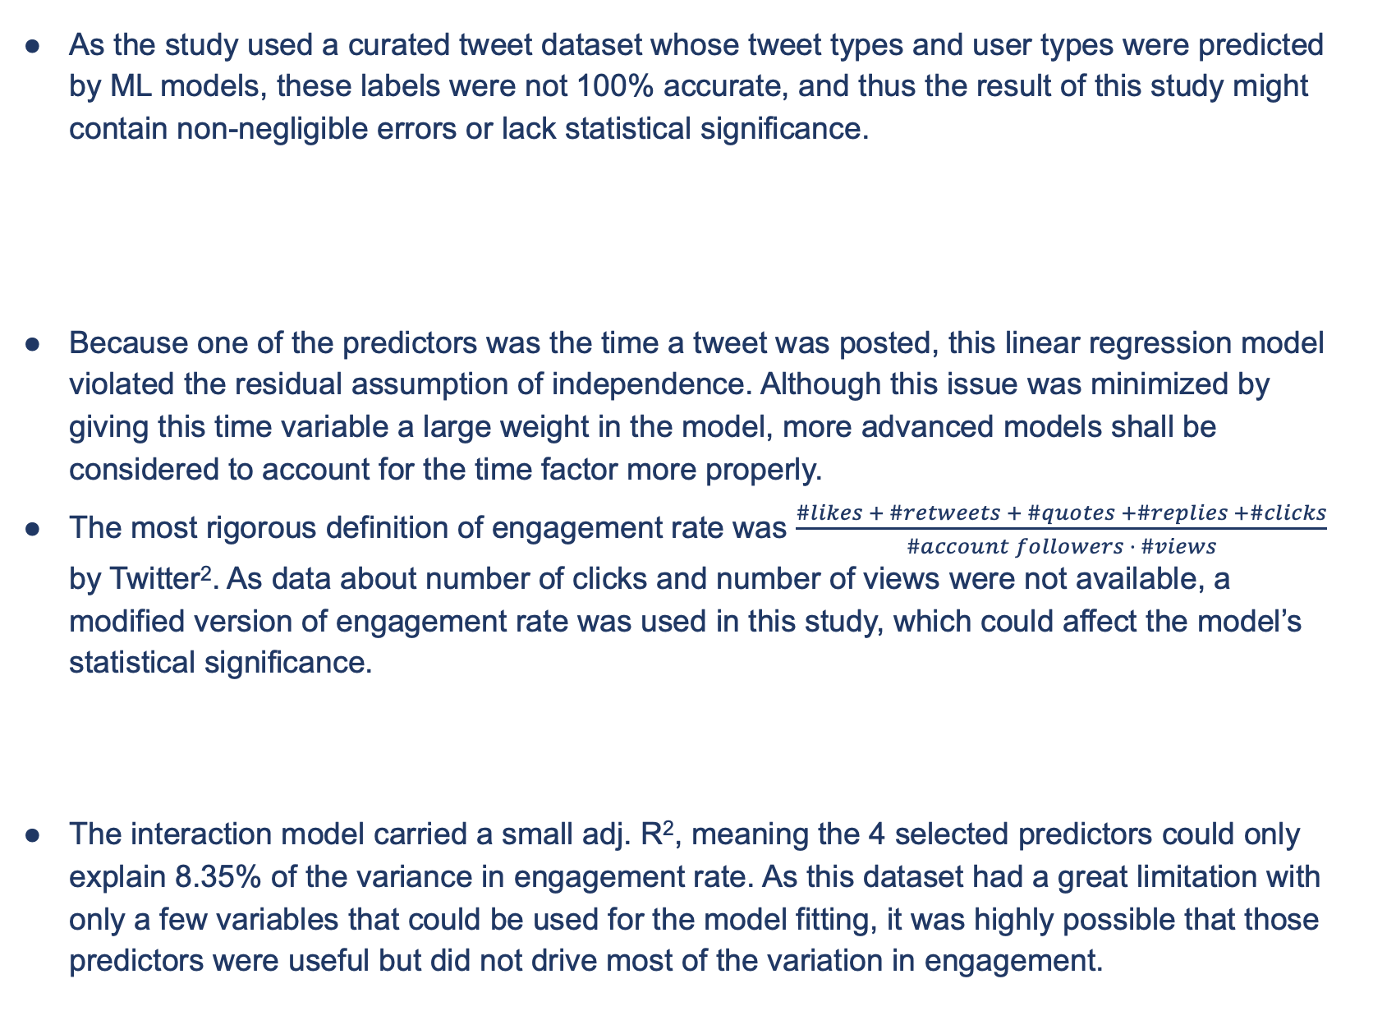
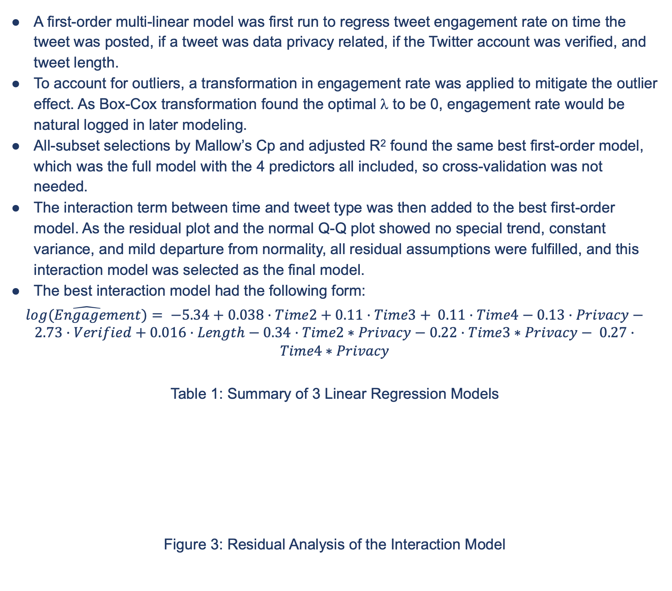
Twitter Engagement Associated with Concerning Period Tracker Data Privacy
Candice (Siyuan) Ye ’23, Data Science Major Capstone
Background and Research Questions
Figure 2: Logged Engagement Rate by 4 Periods
Results
On Jun 24, 2022, the U.S. Supreme Court overturned Roe v. Wade, the landmark piece of legislation that made access to abortion a federal right in the U.S. There are now 11 U.S. states restricting illegal abortion, and investigations about illegal abortion since the overturn frequently reference individual data points from period trackers and social media as evidence.
As some people were against the overturn decision as well as the government’s and the police’s access to their private data granted by period trackers, there might be increased attention and discussion about period tracker related privacy around the overturn.
The CS 234 final project successfully detected an increase in the proportion of tweets discussing period tracker data privacy between the Roe v. Wade leak and the overturn.
Figure1: Proportion of Period Tracker Related Tweets that Expressed Data Concern, 2021 - 2022
This study extended on the previous project and testified if such tweets also had higher engagement rate around this time.
Surprisingly, the model showed a statistically significant, negative relationship between engagement rate and posting a tweet about period tracker data privacy between the leak and the overturn. This could mean the public was rather focusing on other issues when the overturn news came out.
The model also showed a statistically significant, negative relationship between engagement rate and posting a tweet about period tracker data privacy a month after the decision. This result was expected, as people usually held less interest in old news as time passed.
Figure 4: Engagement Rate of Tweets Mentioning Period Trackers, 2021 - 2022
Data Modeling: Interaction Model
A first-order multi-linear model was first run to regress tweet engagement rate on time the tweet was posted, if a tweet was data privacy related, if the Twitter account was verified, and tweet length.
To account for outliers, a transformation in engagement rate was applied to mitigate the outlier effect. As Box-Cox transformation found the optimal λ to be 0, engagement rate would be natural logged in later modeling.
All-subset selections by Mallow’s Cp and adjusted R² found the same best first-order model, which was the full model with the 4 predictors all included, so cross-validation was not needed.
The interaction term between time and tweet type was then added to the best first-order model. As the residual plot and the normal Q-Q plot showed no special trend, constant variance, and mild departure from normality, all residual assumptions were fulfilled, and this interaction model was selected as the final model.
The best interaction model had the following form:
$\hat{log(Engagement)}= −5.34+0.038·Time2+0.11·Time3+ 0.11·Time4−0.13·Privacy−2.73·Verified+0.016·Length−0.34·Time2∗Privacy−0.22·Time3∗Privacy− 0.27·Time4∗Privacy$
Table 1: Summary of 3 Linear Regression Models
Figure 3: Residual Analysis of the Interaction Model
Data Ethics and Limitations
As the study used a curated tweet dataset whose tweet types and user types were predicted by ML models, these labels were not 100% accurate, and thus the result of this study might contain non-negligible errors or lack statistical significance.
Because one of the predictors was the time a tweet was posted, this linear regression model violated the residual assumption of independence. Although this issue was minimized by giving this time variable a large weight in the model, more advanced models shall be considered to account for the time factor more properly.
The most rigorous definition of engagement rate was $\frac{\#likes + \#retweets + \#quotes +\#replies +\#clicks}{\#account followers · \#views}$ by Twitter². As data about number of clicks and number of views were not available, a modified version of engagement rate was used in this study, which could affect the model’s statistical significance.
The interaction model carried a small adj. R², meaning the 4 selected predictors could only explain 8.35% of the variance in engagement rate. As this dataset had a great limitation with only a few variables that could be used for the model fitting, it was highly possible that those predictors were useful but did not drive most of the variation in engagement.
Data
Tweet | Privacy
“@Apple is the period tracker data safe? . . .” | 0
“@phiinnaaa I’ve been using Period tracker for years now…” | 1
Description
The original tweet data was extracted from the Twitter Web API, which had 195,875 unique tweets and 131,495 unique users from Oct 15, 2021 to Oct 14, 2022.
To quantify the proportion of unofficial tweets discussing period tracker data privacy, the CS 234 final project trimmed the original dataset by labeling user and tweet types with ML models of Naïve Bayes and Logistic Regression.
This study was based on the trimmed dataset, which only contained individual users and period tracker related tweets.
This dataset had 26,092 rows and 20 columns, such as the tweet content, time a tweet was posted, number of retweets, and if a tweet was data privacy relevant.
Cleaning / Modification
Time a tweet was posted: It was converted from a continuous time variable to a categorical variable to catch the association between a tweet’s engagement rate and when it was posted. The 4 categories were pre-leak (Oct 15, 2021 ~ May 1, 2022), leak to overturn (May 2, 2022 ~ Jun 23, 2022), the month of overturn (Jun 24, 2022 ~ Jul 23, 2022), and post-decision (Jul 24, 2022 ~ Oct 14, 2022).
Engagement rate: The engagement rate for a tweet was defined as engagement over impression by Twitter¹, here calculated as $\frac{\#likes + \#retweets + \#quotes +\#replies}{\#account followers}$ based on these 5 variables from the original dataset. To account for tweets that have 0 impressions or 0 engagement, both the numerator and the denominator were transformed by being added 1, so the modified engagement rate became $\frac{\#likes + \#retweets + \#quotes + \#replies + 1}{\#account followers + 1}$
Tweet length: This new variable was created by counting the number of words in a tweet.
Model | Adj. R²
$$Engagement \sim Time+Privacy+Verified+Length$$ | 0
$$log⁡(Engagement) \sim Time+Privacy+Verified+Length$$ | 0.083
$$\log\left(Engagement\right)\sim Time+Privacy+Time∗Privacy+ Verified+Length$$ | 0.084
User | Privacy | Engagement | Impression | Engagement Rate
Seventeen | 1 | 1 | 1,260,328 | 0
References
[1] “Twitter API Documentation.” Twitter, Twitter, 2023. https://developer.twitter.com/en/docs/twitter-api
[2] “About your activity dashboard.” Twitter, Twitter, 2023. https://help.twitter.com/en/managing-your-account/using-the-tweet-activity-dashboard#:~:text=To%20access%20your%20Tweet%20activity,icon%20visible%20in%20your%20Tweets.

